Slide 1

Arlington, VA Housing Data Analysis: Does Proximity to Metro Impact Home Values?
GW Data Bootcamp: Project 1, Team 7

Slide 2

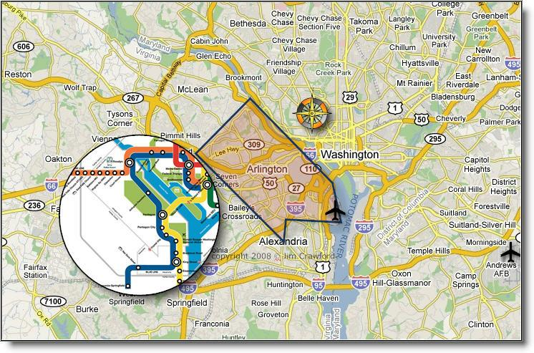

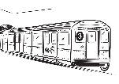
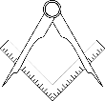
Project Introduction
Project Team 7: Awesome Aimal, Master Matt, and K8tastic
Overview and Hypothesis
Central Hypothesis
Is there a correlation between housing prices and distance to a metro station in Arlington, VA?
Data Sources:
Arlington Country Records
Google
Maps API
MPU library
Limitations and Assumptions: We used tax assessed value as a proxy for residence price. Residences include condos, houses, etc. Information such as sqft and number of bedrooms was not available with this data set.

Slide 3
Data Exploration and Cleaning
Breaking down the methodology into steps allowed each of us to develop sections of code simultaneously (vs sequentially)
Data Cleaning
Create metro list (11 total)
Identify housing data (~37,000 addresses)
Import csv file
Remove commercial, etc. real estate (~32,000 addresses remaining)
Data cleaning
Randomly select subsample of 10,000* to limit number of API calls
Find lat/long of each house and metro address using Google Maps AP**
Identify lat and long
Using Haversine equation to calculates distance between two points using lat/long (from MPU library) let us avoid using Google Maps Distance function
After calculating distance between each house and each metro, we selected smallest distance (i.e, distance between house and nearest metro)
Calculate distances
Created a heat map of area with houses and metro stations for geospatial visualization
Graphed relationship between distances and house assessed value
Map and plot data
*Using uniform distribution sampling functions resulted in too many duplicates, went with random
** Set timer for API based on documentation of 50 queries/second. In reality, latency (average response time) was over 2 queries/second = 1.5 hours to query 10,000 addresses

Slide 4



Methodology Review
In addition to working on python coding skills (cleaning dataframes, doing API calls, nested for-loops, mapping, etc.), there were other methodological issues that arose with the data.
Methodology Review
Information is money*
Organization is key
Look for workarounds**
* ~11,000 queries to the Google Maps API was $60
** Used a proxy for price, reduced sample size, used alternate methods to calculate distance

Slide 5
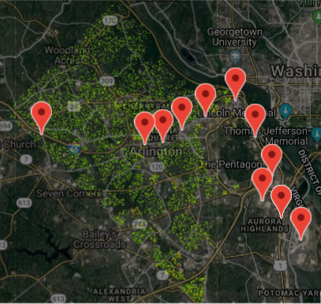

Geographical Distribution
of Housing Sample
The information below outlines key aspects of the Arlington County, VA geographical housing data distribution.
Housing Sample Geographical Distribution
Arlington Housing Data
10,000 properties represented
11 metro stations mapped to Arlington County, VA
9 zip codes represented
Least valued property assessed: $75,100
Most valued property assessed: $10,006,300

Slide 6

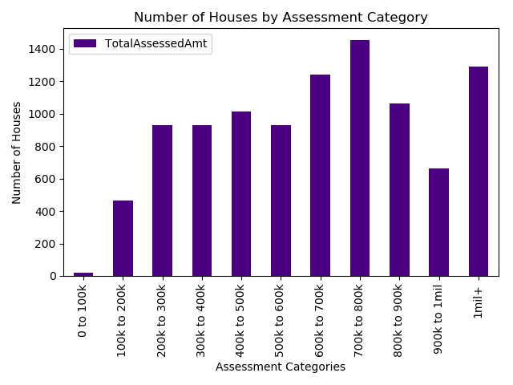

Total Number of Residences
by Assessment Category
The information below outlines the total number of houses bucketed according to their assessed value for tax purposes.
Properties by Assessment Category
Data Distribution
Value | Total
$0 – $100K | 19
$100K – $200K | 465
$200K – $300K | 929
$300K – $400K | 931
$400K – $500K | 1013
$500K – $600K | 930
$600K – $700K | 1243
$700K – $800K | 1453
$800K – $900K | 1064
$900K – $1M | 663
$1M+ | 1290
66% of the properties in the sample are valued at $500,000 or more.

Slide 7

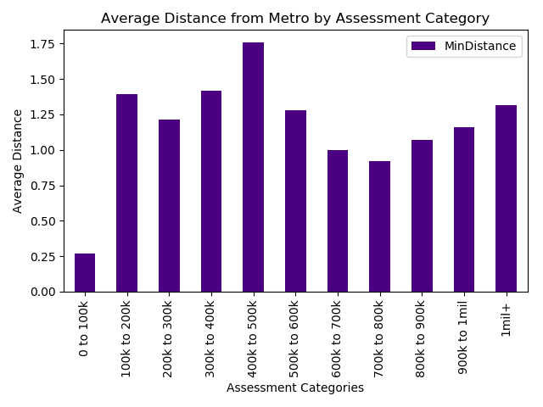

Average Distance from Metro
by Assessed Property Value
The information below outlines the average distance from metro for properties according to their assessed value.
Average Distance by Assessed Property Value
Data Distribution
Value | Distance (Miles)
$0 – $100K | 0.267859
$100K – $200K | 1.390534
$200K – $300K | 1.212122
$300K – $400K | 1.418037
$400K – $500K | 1.757280
$500K – $600K | 1.276359
$600K – $700K | 0.996239
$700K – $800K | 0.921796
$800K – $900K | 1.068301
$900K – $1 M | 1.161208
$1 M+ | 1.312829
The distribution of data does not indicate a discernible correlation between average distance from a metro station and assessed property value.

Slide 8
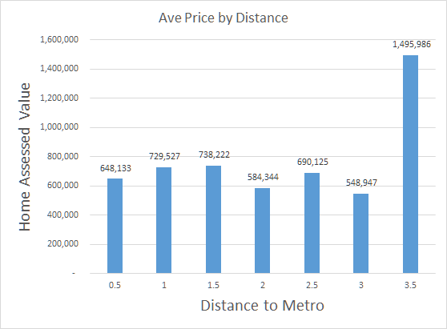
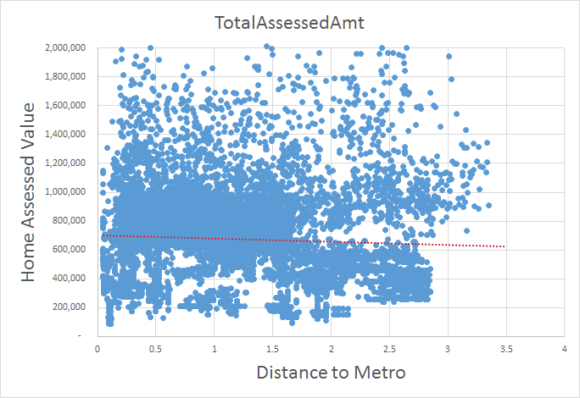
Average Home Price by Distance to Metro
Correlation Between Home Price and Distance to Metro
The distribution of data does not indicate a discernible correlation between average distance from a metro station and assessed property value.
Several extreme outliers (e.g., homes of $10M skewed the data set, particularly at 3.5 miles).

Slide 9
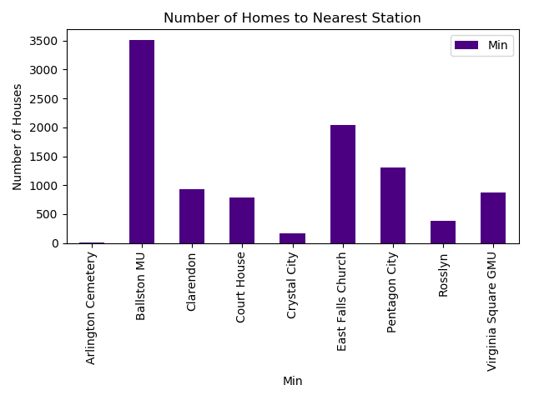
Total Homes per Nearest Metro Station
by Assessed Property
Total Homes per Nearest Station
Data Distribution
Metro | Number of Residences
Arlington Cemetery | 8
Ballston | 3,517
Clarendon | 930
Courthouse | 784
Crystal City | 161
East Falls Church | 2,040
Pentagon City | 1,303
Rosslyn | 378
Virginia Square | 879

Slide 10
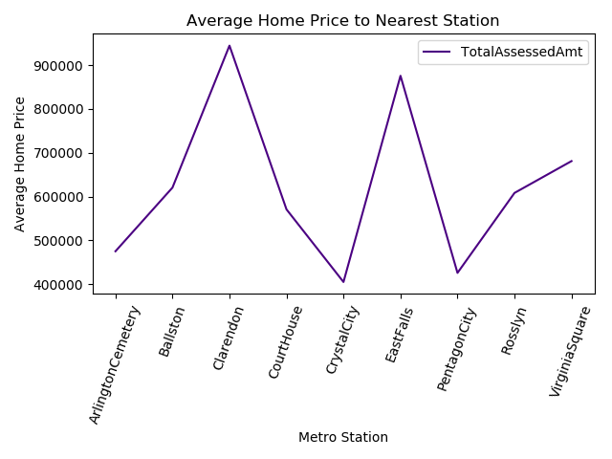
Average Home Price to Nearest Metro Station
Average Home Price to Nearest Station
Data Distribution
Metro | Average Home Price
Arlington Cemetery | 475,350
Ballston | 620,650
Clarendon | 944,657
Courthouse | 571,014
Crystal City | 405,277
East Falls Church | 875,793
Pentagon City | 426,035
Rosslyn | 608,487
Virginia Square | 681,123

Slide 11




Conclusion, Implications, and
Remaining Questions
Conclusion, Implications, & Questions
Based on our assessment, there does not appear to be a discernible impact on distance to metro and property value.
•
Home values in the North Arlington area have the highest average assessed property value.
More research needs to be done into the impact of identified outliers, along with isolated stations, on the data set.
Additional variables (square footage, etc.) should be examined to determine how they impact the initial research question.

